Slide 1
2CEIT502 Software Engineering
GANPAT UNIVERSITY
U. V. PATEL COLLEGE OF ENGINEERING
Unit 5
SOFTWARE PROJECT MANAGEMENT (SPM)
Prepared by: Prof. Ravi Raval (Asst. Prof in C.E Dept. , UVPCE)

Slide 2
Unit 5: Software Project Management
Contents:
5.1 Introduction
5.2 Responsibility of Software Project Manager
5.3 Project Planning
5.4 Project Planning activities
5.5 SPMP Document
5.6 Metrics for Project Size Estimation
5.7 Project Estimation Techniques
5.8 Scheduling

Slide 3
Unit 5: Software Project Management
5.1 Introduction
The main goal of software project management is to enable a group of software developers to work efficiently towards successful completion of the project.

Slide 4
Unit 5: Software Project Management
5.2 Responsibilities of a Software Project Manager:
Job Responsibilities:
The responsibilities and activities of a software project manager is large and varied.
Building up team morale to highly visible customer presentations
Project proposal writing
Project cost estimation
Scheduling
Project staffing
Software Process tailoring
Project monitoring and control
Software configuration management
Risk management
Interfacing with clients
Managerial report writing and presentations

Slide 5
Unit 5: Software Project Management
5.2 Responsibilities of a Software Project Manager:
Job Responsibilities:
Classification of all responsibilities
Project Planning:
Estimating activities
Planning according to estimation
Feasibility study
Revise plan
Project monitoring and controlling activities:
Ensure development progress as per plan

Slide 6
Unit 5: Software Project Management
5.2 Responsibilities of a Software Project Manager:
Skills to be possessed by software project manager:
Good quality judgment
Decision making capabilities
Knowledge of latest software project management techniques
Cost estimation
Risk management
Configuration management
Good communication skills
Ability to get work done
Skills to track and control software progress
Customer interaction
Managerial presentation
Team building

Slide 7
Unit 5: Software Project Management
5.3 Project Planning and it’s activities
Activities of project planning:
Estimation
Cost
Duration
Effort
Scheduling manpower and resources
Staffing
Risk Management
Miscellaneous plans: e.g. Quality assurance plan, configuration management plan etc.
Effort Estimation
Cost Estimation
Size Estimation
Duration Estimation
Project Staffing
Scheduling

Slide 8
Unit 5: Software Project Management
5.5 The Software Project Management Plan (SPMP) Document
Once the project planning is complete, project managers document their plans in a SPMP document. Here is the template of SPMP document.
1. Introduction
(a) Objectives
(b) Major Functions
(c) Performance Issues
(d) Management and Technical Constraints
2. Project estimates
(a) Historical Data Used
(b) Estimation Techniques Used
(c) Effort, Resource, Cost, and Project Duration Estimates
3. Schedule
(a) Work Breakdown Structure
(b) Task Network Representation
(c) Gantt Chart Representation
(d) PERT Chart Representation
4. Project resources
(a) People
(b) Hardware and Software
(c) Special Resources
5. Staff organisation
(a) Team Structure
(b) Management Reporting
6. Risk management plan
(a) Risk Analysis
(b) Risk Identification
(c) Risk Estimation
(d) Risk Abatement Procedures
7. Project tracking and control plan
(a) Metrics to be tracked
(b) Tracking plan
(c) Control plan
8. Miscellaneous plans
(a) Process Tailoring
(b) Quality Assurance Plan
(c) Configuration Management Plan
(d) Validation and Verification
(e) System Testing Plan
(f) Delivery, Installation, and Maintenance Plan

Slide 9
Unit 5: Software Project Management
5.6 Metrics for Project size estimation
Project size? What we mean by size of the project? And Why we need to find it?
Currently there are two metrics popular in size estimation:
Lines of Code (LoC) metric
Function Point (FP) metric
The term project size is a measure of the problem complexity in terms of the effort and time
required to develop the software.

Slide 10
Unit 5: Software Project Management
5.6 Metrics for Project size estimation
(1) Lines of Code (LoC)
It measures the size of project by counting the no. of source instruction in the developed program. While counting it ignores comments and header lines of program.
Estimating LoC is easy at the end of project. Anybody can do it. But how to get an estimation of LoC at the beginning of the project?
So, what is the solution to get a near about perfect estimation of LoC at the beginning of the project?
Divide the main problem (software to be developed) into modules; modules into sub-modules;
and so on until the leaf-level modules can be approximately predicted

Slide 11
Unit 5: Software Project Management
5.6 Metrics for Project size estimation
(1) Lines of Code (LoC)
Disadvantages:
Numerical value of a problem size can vary programmer to programmer.
LoC is a measure of coding activity alone. Problem size not only depends on code only but design and test also.
LoC correlates poorly with the quality and efficiency of the code. “Large code doesn’t imply high quality/efficiency.
LoC metric penalizes use of higher-level programming languages, Code reuse etc. Several library routine call will result lower count.
LoC matric measures the lexical complexity of a program and does not address the more important but subtle issues of logical or structural complexities. i.e. complex logic program requires more effort than simple logic.
Biggest shortcoming: It’s very difficult to accurately estimate LoC in the final product from just the problem specification.

Slide 12
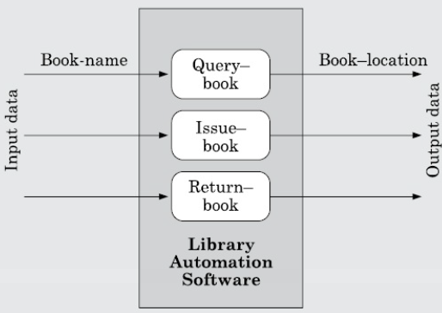
Unit 5: Software Project Management
5.6 Metrics for Project size estimation
(2) Functional Point (FP) Metric
It overcomes several shortcomings of LoC.
The important advantage of using the FP metric is that it can be easily used to estimate the size of project directly from software specification where as in LoC, the size can be accurately determined only after the product has fully developed.
The conceptual idea behind the function point metric is that the size of a software product is directly dependent on the no. of different functions or features it supports.

Slide 13
Unit 5: Software Project Management
5.6 Metrics for Project size estimation
(2) Functional Point (FP) Metric
Steps to calculate function point (FP)
Step 1: First of all calculate “unadjusted function point (UFP)”
UFP = (Number of inputs) * 4 + (Number of outputs) * 5 + (number of inquiries) * 4 + (number of files) * 10 + (number if interfaces) * 10
Where,
No. of inputs: Each data item input by the user is counted. Data inputs should be distinguished from user inquiries.
No. of outputs: reports printed, screen outputs, error messages, audio
No. of inquiries: user commands to perform specific action
No. of files: Each logical file (group of logical data) is counted.
No. of interfaces: interfaces used to exchange info with other system.

Slide 14
Unit 5: Software Project Management
5.6 Metrics for Project size estimation
(2) Functional Point (FP) Metric
Steps to calculate function point (FP)
Step 2: Refine UFP in this step. But how to refine?
The complexity level of each of the parameters as are graded as simple, average or complex. The weights for the different parameters can then be compared based on this table.
Technical complexity factor (TCF): are such factors which can influence the development effort such as:
High transaction rates
Response time requirements
Scope of reuse etc.
 | Simple | Average | Complex
Input (I) | 3 | 4 | 6
Output (O) | 4 | 5 | 7
Inquiry (E) | 3 | 4 | 6
No. of links (F) | 7 | 10 | 15
No. of interfaces | 5 | 7 | 10

Slide 15
Unit 5: Software Project Management
5.6 Metrics for Project size estimation
(2) Functional Point (FP) Metric
Steps to calculate function point (FP)
Step 2 (continue):
There are 14 such factors which can influence development.
Assign values all those 14 factors as per following:
0 – not present / no influence to
6 – strong influence
The resulting numbers are summed which calls degree of influence (DI).
Now TCF can be computed as : (0.65 + 0.01 * DI)
(DI can vary from 0 to 84 and TCF can vary 0.65 to 1.35)
Step 3: Finally, FP = UFP * TCF.

Slide 16
Unit 5: Software Project Management
5.6 Metrics for Project size estimation
Shortcomings of Function Point (FP)
Major: it does not take into account the algorithmic complexity of a function.
That means FP assumes that the efforts required to design and develop any two different functionalities of the system is the same. Which is not true.
For Ex. In Library management system, “create member” function would be much simpler to develop then “loan from remote library” function.
FP only considers the number of functions that the system supports, without distinguishing the difficulty levels of developing the various functionalities.
To overcome this, an extension to FP metric called feature point metric has been proposed which includes algorithmic complexity as an extra parameter.

Slide 17
Unit 5: Software Project Management
5.6 Metrics for Project size estimation
Difference between FP and LOC
Function Point (FP) | Lines of Code (LoC)
1. FP is specification based. | 1. LOC is an analogy based.
2. FP is language independent. | 2. LOC is language dependent.
3. FP is user-oriented. | 3. LOC is design-oriented.
4. It is extendible to LOC. | 4. It is convertible to FP (backfiring)

Slide 18
Unit 5: Software Project Management
5.7 Project estimation Techniques
What to estimate? Size, efforts, duration and cost
Why to estimate? For resource planning, scheduling and giving quotation to customers.
Lots of estimation techniques are available but they are classified into three categories:
5.7.1 Empirical Estimation Techniques
Expert Judgment Technique
Delphi Cost Estimation.
5.7.2 Heuristics Techniques
Single Variable Model (Basic COCOMO Model)
Multi variable model (Intermediate COCOMO Model)
5.7.3 Analytical estimation techniques (Halstead’s Software Science)
Length and Vocabulary
Program volume
Potential Minimum Volume
Effort and Time
Length Estimation

Slide 19
Unit 5: Software Project Management
5.7 Project estimation Techniques
5.7.1 Empirical Estimation Techniques
Based on similar products development experience
Based on making an educated guess of the project parameters.
Expert Judgment Technique:
Experts makes an educated guess of problem size after analysis
Subjected to human error and individual bias.
Sometimes experts have not expertise on all aspect of project
Delphi Cost Estimation: Coordinators and Experts group
Coordinator will provide a copy of SRS to each expert and a form to record their estimation.
Expert will estimate and submit estimation individually and anonymously.
Coordinator will prepare a summary of responses of all estimation.
Again, share the summary to expert to re-estimate
Iterate the chain until the final compiled result is produced.

Slide 20
Unit 5: Software Project Management
5.7 Project estimation Techniques
5.7.2 Heuristic Techniques
Identify the basic project parameters.
Create other (dependent) parameters from basic parameters.
Single Variable Model
Estimated Parameter = C₁*e^{d1} Where,
e: characteristics of software which has been already estimated
Estimated parameter is dependent parameter to be estimated (e.g. effort, duration, staff size)
C1 & D1 are constants values collected from past projects / historical data
E.g. COCOMO model
Multi Variable Model
Estimated Resources = C_{1*}ep₁^{d1} +C₂*ep₂^{d2} + … Where,
Ep₁,ep₂-Basic characteristics of the software already estimated
C₁,C₂,D₁,D₂,… are constants
It gives more accurate estimation.
E.g. Intermediate COCOMO model.

Slide 21
Unit 5: Software Project Management
5.7 Project estimation Techniques
5.7.2 Heuristic Techniques
1) COnstructive COst estimation MOdel (COCOMO)
Any software development project can be classified into any one of the following three categories based on the development complexity:
Organic
Semidetached
Embedded
We are categorizing the software which is to be developed in three categories:
Application Programs: e.g. Word processing software, accounting software etc.
Utility Programs: e.g. Compiler, linker etc.
System Softwares: e.g. real time system, operating system etc.
The ratio of development complexity is: 1:3:9
That means if any application software which requires say ‘X’ efforts to develop then utility software will require 3X times efforts and 9X times efforts for system softwares.

Slide 22
Unit 5: Software Project Management
5.7 Project estimation Techniques
5.7.2 Heuristic Techniques
1) COnstructive COst estimation MOdel (COCOMO)
A) Organic: < 50 K LOC (e.g. Pay Load System)
well-understood application
Development team size is reasonably small
Experienced team members
B) Semidetached: 50 K < LOC < 300 K (e.g. Compiler)
Mixture of experienced and inexperienced development team
Limited experience on related system development.
Unfamiliar with some aspects of system being developed.
C) Embedded: LOC > 300 K (ATM, Air traffic control system)
If the software being developed its strongly coupled to complex hardware, or if stringent regulations on the operation exist

Slide 23
Unit 5: Software Project Management
5.7 Project estimation Techniques
5.7.2 Heuristic Techniques
1) COnstructive COst estimation MOdel (Basic COCOMO)
Gives estimate about project parameter
Effort= a₁ x (KLOC)^{a2} PM (Person months)
T_{dev} = b₁ x (effort)^{b2} Months
Where, KLOC - estimated size of software in Kilo Lines of Code
a₁,a₂,b₁,b₂ – constants for each software product category
T_{dev} – estimated time to develop (in Months)
Efforts – efforts required to develop (in Person Months)
 | Development effort estimation | Development time estimation
Organic | 2.4 (KLOC)^{1.05} PM | 2.5 (effort)^{0.38} Months
Semidetached | 3.0 (KLOC)^{1.12} PM | 2.5 (effort)^{0.35} Months
Embedded | 3.6 (KLOC)^{1.20} PM | 2.5 (effort)^{0.32} Months

Slide 24
Unit 5: Software Project Management
5.7 Project estimation Techniques
5.7.2 Heuristic Techniques
1) COnstructive COst estimation MOdel (Basic COCOMO)
Ex: Assume that the size of an organic type of software product has been estimated to be 32,000 lines of source code. Assume that the average salary of software developers in Rs. 15,000 per month. Determine the effort required to develop the software product, the nominal development time, and the cost of develop the product.
Solution:
Efforts = 2.4 x (32)^{1.05} = 91 Person Months (PM)
Nominal development time = 2.5 x (91)^{0.38} = 14 Months
Cost = 91 x 15,000 = Rs. 14,65,000

Slide 25
Unit 5: Software Project Management
5.7 Project estimation Techniques
5.7.2 Heuristic Techniques
2) Intermediate COnstructive COst estimation MOdel (Intermediate COCOMO)
Basic COCOMO assumes that effort and development time are functions of the product size alone.
The intermediate COCOMO model recognize all other project parameters which may affect effort and development time; It refines the initial estimate obtained using the basic COCOMO expression by using a set of 15 cost drivers (multipliers) based on various attributes of software development
Different cost drivers:
Product related: complexity of the product, reliability
Computer related: Execution speed, storage space etc.
Personnel related: experience level, programming / analysis capability
Development environment related: automation tools (e.g. CASE tool)

Slide 26
Unit 5: Software Project Management
5.7 Project estimation Techniques
5.7.3 Analytical Estimation Techniques : Halstead’s software science
To measure size, development effort, and development cost of software products
For a given program, Let
n₁- no. of unique operators used in the program
n₂- no. of unique operands used in the program
N₁- total no. of operators used in the program
N₂- total no. of operands used in the program
How to identify operators?
Arithmetic, Logical, assignment operators
() and {}
Label of GOTO statement
If, if…then…else…endif, while, for, do ;
How to identify operands?
Function name, variable name, function name in function call, arguments in function call
But remember…! Parameter list in function declaration is not considered as operands

Slide 27
Unit 5: Software Project Management
5.7 Project estimation Techniques
5.7.3 Analytical Estimation Techniques : Halstead’s software science
Length and vocabulary:
Length of a program (N) = N₁ + N₂
Program’s vocabulary (n) = n₁ + n₂
Program’s Volume:
Length of a program depends on choice of operators and operands
For the same programming problem, length of program may differ because of programming style and programming language used
V = N Log₂ n where V - min. no. of bits need to encode the program
n - unique different identifiers / program’s vocabulary
So, we need N Log₂ n bits to store a program having length N
Potential Minimum Volume:
The potential minimum volume V* is defined as the volume of the most succinct program in which a problem can be coded. The minimum volume is obtained when the program can be expressed using a single source code instruction, say a function call like foo ();
Thus if an algorithm operates on input and output data (d₁, d₂, … , d_{n}) the most succinct program would be f(d₁,d₂,…,d_{n}); for which n₁=2, n₂=n therefore

Slide 28
Unit 5: Software Project Management
5.7 Project estimation Techniques
5.7.3 Analytical Estimation Techniques : Halstead’s software science
V* = ( 2 + n₂ ) Log₂ ( 2 + n₂ )
Program level L=V*/V
Higher the program level → less effort to develop
d) Efforts and Time:
Efforts need to develop a program E = V (volume of the program) / L (Level of programming lang. used)
E=V²/V (where E is no. of mental discrimination required to implement the program and also the effort required to read and understand the program.)
T=E/S (S-speed of mental discriminations S=18 empirically psychologically decided)
e) Length Estimation:
Halstead suggests a way to determine the length of a program using the no. of unique operators and operands used in the program.
By this method, length, cost, volume, efforts etc. can be determined before even starting the programming.
Any program of length N consist of N/n unique strings of n (length). Now it is standard combinational result that for any given alphabet of size K, these are exactly K^{r} different strings of length r. Thus

Slide 29
Unit 5: Software Project Management
5.7 Project estimation Techniques
5.7.3 Analytical Estimation Techniques : Halstead’s software science
N/n ≤ n^{n} or N ≤n^{n+1}
Upper bound can be (as operators and operands may duplicates)
So N ≤ nn₁^{n1}n₂^{n2}
N must include all possible subsets of that ordered set.
2N=nn₁^{n1}n₂^{n2}
Take log both side: N=log₂n+log₂(n₁^{n1}n₂^{n2})
So we get, N=log₂(n₁^{n1}n₂^{n2}) (approximately, by ignoring log₂N)
Or N = log₂n₁^{n1}+log₂n₂^{n2} = n₁log₂n₁ + n₂log₂n₂

Slide 30
Unit 5: Software Project Management
5.7 Project estimation Techniques
5.7.3 Analytical Estimation Techniques : Halstead’s software science
Example: Find out estimated length and volume of following C program
main()
{
int a, b, c, avg;
scanf(“%d %d %d”, &a, &b, &c);
avg=(a+b+c)/3;
printf(“avg=%d”,avg);
}
Solution: Step-1: First, Find out the total number of unique operators used: 12
main, (), {}, int, scanf, &, “,”, “;”, = , +, /, printf
Step-2: Find out the total number of unique operands used:11
“%d %d %d”,a+b+c, a, b, c, &a, &b, &c, avg=%d, avg, 3
Step-3: Therefore, here n₁=12, n₂=11
Now, estimated Length
(N) = n₁log₂n₁ + n₂log₂n₂
= (12*log₂12) + (11*log₂11)
= 43+38
= 81
Volume(V)= N * Log₂ n
= 81 * log₂(23)
= 81 * 4.52
= 366

Slide 31
Unit 5: Software Project Management
5.8 Scheduling
Scheduling defines that which task should be taken up when
How to schedule project activities:
Identify all tasks needed to complete the project.
Breakdown large task into small activities.
Determine the dependency among different activities
Establish the most likely estimates for the time duration necessary to complete the activities
Allocate resources to activities
Plan the starting and ending dates for various activities
Determine the critical path: A critical path is a chain of activities that determines the duration of project.
The end of each activity is called Milestone

Slide 32
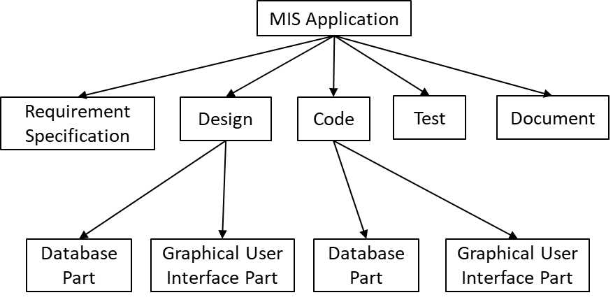
Unit 5: Software Project Management
5.8 Scheduling
5.8.1 Work Breakdown Structure
Work breakdown structure (WBS) is used to recursively decompose a given set of activities into smaller activities.
First, let us understand why it Is necessary to break down project activities into tasks.
Once project Activities have been decomposed into a set of Tasks using WBS, the time frame when each activity is to be performed is to be determined. The end of each important activity is called a milestone. The project manager tracks the progress of a project by monitoring the timely completion of the milestones. If he observes that some milestones start getting delayed, he carefully monitors and controls the progress of the tasks, so that the overall deadline can still be met.
[Figure 5.1 MIS Problem]

Slide 33
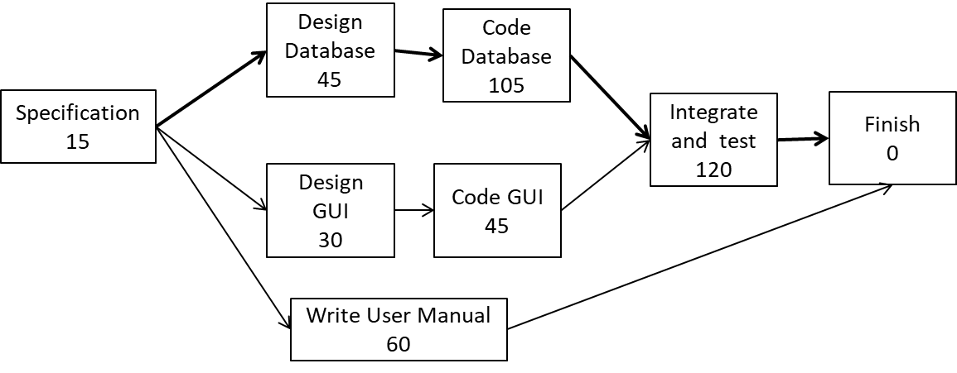
Unit 5: Software Project Management
5.8 Scheduling
Task No. | Task | Duration | Dependency
T1 | Specification | 15 | -
T2 | Design Database | 45 | T1
T3 | Design GUI | 30 | T1
T4 | Code Database | 105 | T2
T5 | Code GUI Part | 45 | T3
T6 | Integrate and Test | 120 | T4 & T5
T7 | Write User Manual | 60 | T1
5.8.2 Activity Networks:
Minimum time: the maximum of all paths from start to finish
So, Here its ( 15 + 45 + 105 + 120 ) = 285
[Figure 5.2 Activity Network]

Slide 34
Unit 5: Software Project Management
5.8 Scheduling
5.8.2 Critical Path Method (CPM):
A path in the activity network graph is any set of consecutive nodes and edges in this graph from the starting node to the last node.
A critical path consists of a set of dependent tasks that need to be performed in a sequence and which together take the longest time to complete.
A Critical task is one with a zero slack time. A path from the start node to the finish node containing only critical tasks is called a critical path.
Minimum time (MT): It is the minimum time required to complete the project. It is computed by determining the maximum of all paths from start to finish.
Earliest start (ES): It is the time of a task is the maximum of all paths from the start to this task. The ES for a task is the ES of the previous task plus the duration of the preceding task.
Latest start time (LST): It is the difference between MT and the maximum of all paths from this task to the finish. The LST can be computed by subtracting the duration of the subsequent task from the LST of the subsequent task.
Earliest finish time (EF): The EF for a task is the sum of the earliest start time of the task and the duration of the task.
Latest finish (LF): LF indicates the latest time by which a task can finish without affecting the final completion time of the project. A task completing beyond its LF would cause project delay. LF of a task can be obtained by subtracting maximum of all paths from this task to finish from MT.
Slack time (ST): The slack time (or float time) is the total time that a task may be delayed before it will affect the end time of the project. The slack time indicates the ”flexibility” in starting and completion of tasks. ST for a task is LS-ES and can equivalently be written as LF-EF.

Slide 35
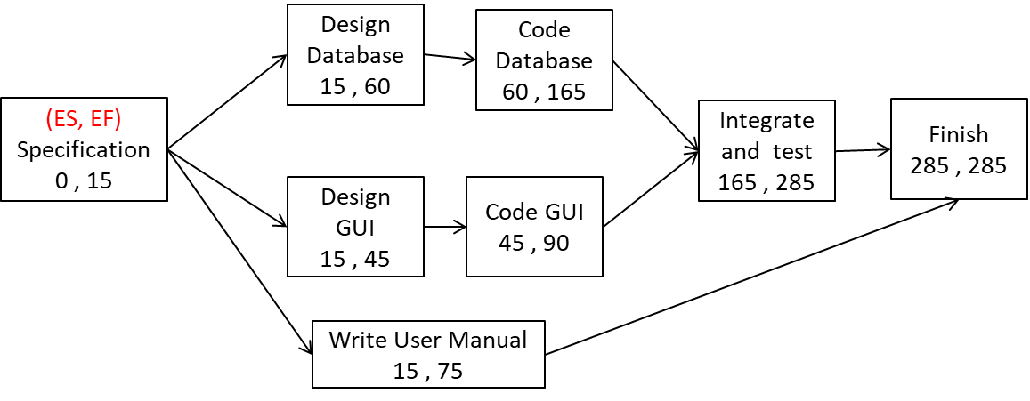
Unit 5: Software Project Management
5.8 Scheduling
5.8.2 Critical Path Method (CPM):
Example: Use the Activity network of Figure 5.2 to determine the ES and EF for every task for the MIS problem
Solution:
[ Figure 5.3 Finding Early Start (ES) and Early Finish (ES) ]

Slide 36
Unit 5: Software Project Management
5.8 Scheduling
5.8.2 Critical Path Method (CPM):
Example: Use the same Activity network of Figure 5.3 to determine the LS, LF and ST for every task for the MIS problem (Remember that our Minimum Time (MT) was 285)
What is Latest Start (LS)? Difference between MT and max of all paths from this task to finish
What is Latest Finish (LF)? MT – (max of all paths from this task to finish)
Task | ES | EF | LS | LF | ST
Specification | 0 | 15
Design Database | 15 | 60
Design GUI | 15 | 45
Code Database | 60 | 165
Code GUI Part | 45 | 90
Integrate and Test | 165 | 285
Write User Manual | 15 | 75

Slide 37
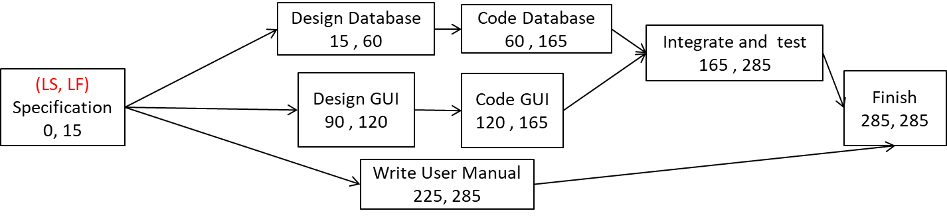
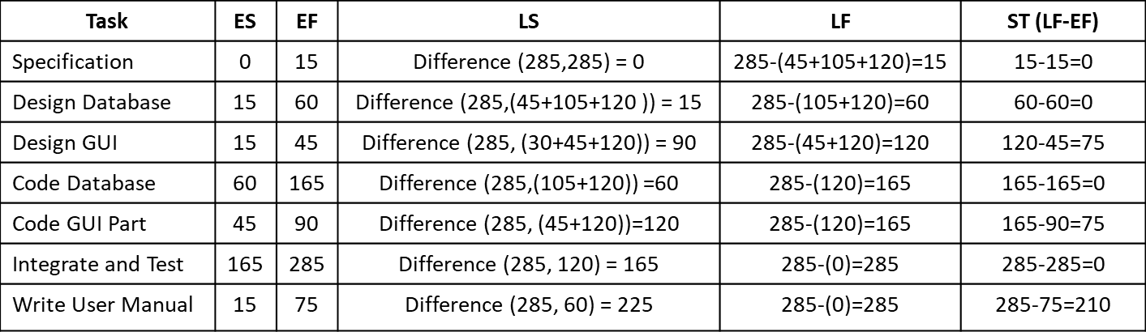
Unit 5: Software Project Management
5.8 Scheduling
[ Figure 5.3 Finding Early Start (ES) and Early Finish (ES) ]

Slide 38
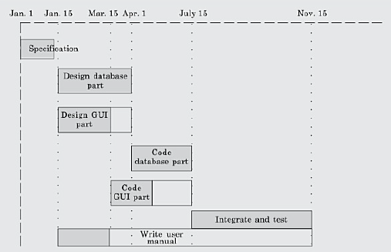
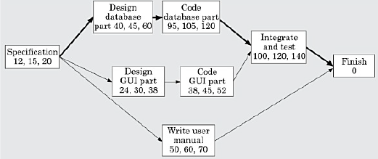
Unit 5: Software Project Management
5.8 Scheduling
Gantt Chart
Used to allocate resources to activities
Shaded part shows length of time where as white bar shows slack time
Pert Chart
Project Evaluation and Review Technique chart
It represents statistical variation in the project estimates assuming a normal distribution

